Slide 1
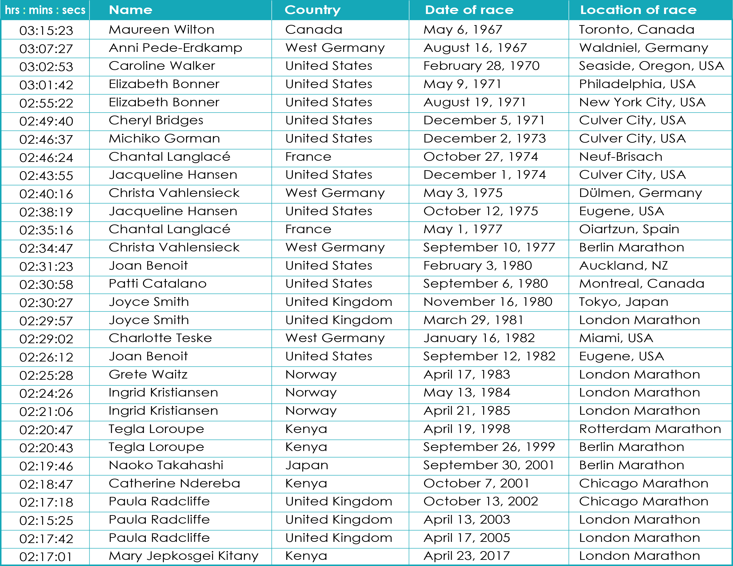
World record times for the Women’s marathon from 1967 to 2017
vrprosthetics.shu.ac.uk
VRP activities – Making sense of it all – Act 2

