Slide 1
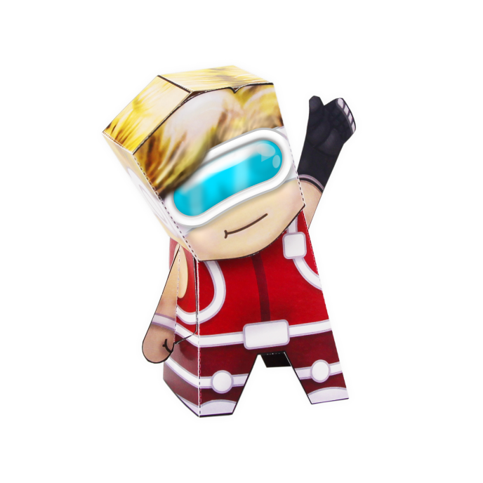
Play the Consequence Wheel Empathy Game
2
2
1
vrprosthetics.shu.ac.uk
2
2
Happening
1
1
2
2
1
2
2

Slide 2
Game cards
losing a limb

Slide 3
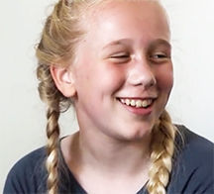
Playing the Consequence Empathy Game
A consequence is an action that has an effect that can either be negative or positive.
This is a game to play having watched Charlotte, Liz and Jon’s stories about their experiences of missing a limb.
Instructions
1
Place the round initial action card ‘Losing a Limb’ on the large playing board, and place in the centre of the board.
Place the other blank cards in a pile.
The first player thinks of one consequence of the action and shares it with the other players. If they agree that it is a consequence then the player takes one of the small cards from the pile and writes on the consequence on it. This is placed on one of the boxes marked with a 1. Take it in turns so all the ‘1’ boxes are filled up.
4
Now, you must fill up the boxes marked with ‘2.’ These are consequences of the suggestions in the ‘1’ boxes.
Continue until all the ‘2’ boxes are completed.
When all boxes are filled, go through each of the ‘2’ boxes and decide if it is a negative or positive consequence (some might be both). Mark all the negative consequences with the red pen and positive with the green pen.
Then, count up how many consequences are negative and how many are positive.
2
5
3
6
vrprosthetics.shu.ac.uk

